Slide 1



Core GYM
Gym management system

Slide 2
Members
Mohamed Yehia 94104
Mostafa Tarek 94071
Mohamed Ezz Elragal 94303
Ahmed Abdelhamed 94120
Abo Elhamad Sharkawy 86517

Slide 3
Main points :
1)The Main of System
2)Project Classes.
3)Project ERD.
4)Application interfaces.
5)List of some GYM members.

Slide 4
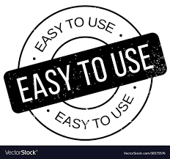
Main of Project
Our System easy to use, You can use in any place. And You can control the gym system from anywhere at any time, and we have many features to manage the gym. And Knowing all the inputs and outputs of the gym at any time. You can see payments and salaries and list of members and employees

Slide 5
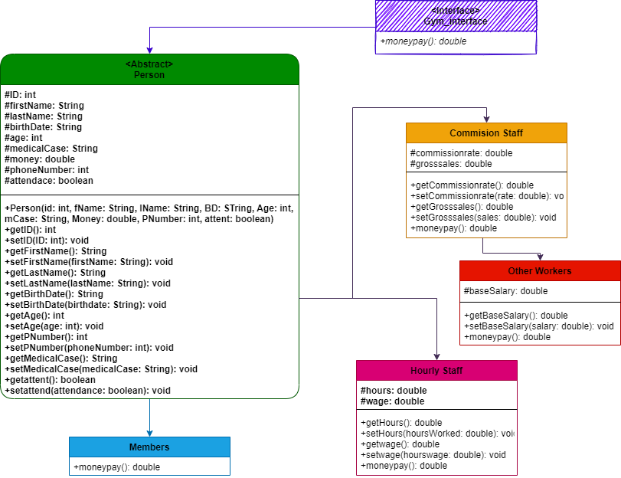
1) Project classes / UML

Slide 6
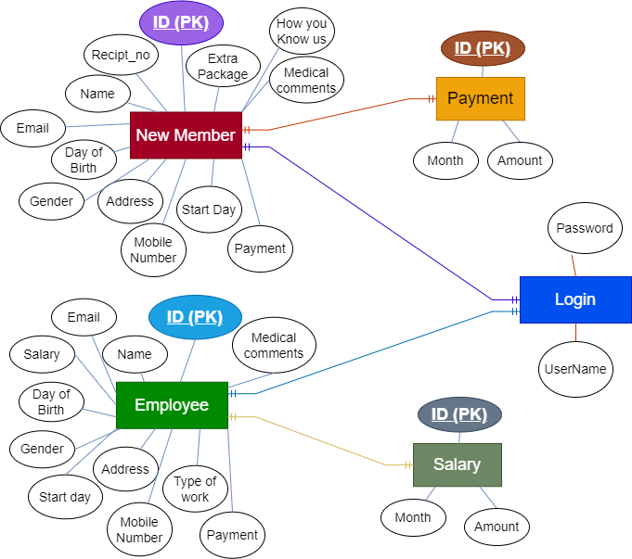
2) Gym ERD

Slide 7
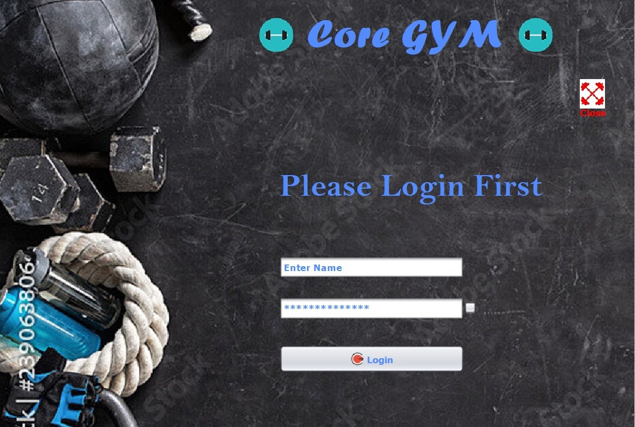
# Login page (user should enter his / her username and password to login ).

Slide 8
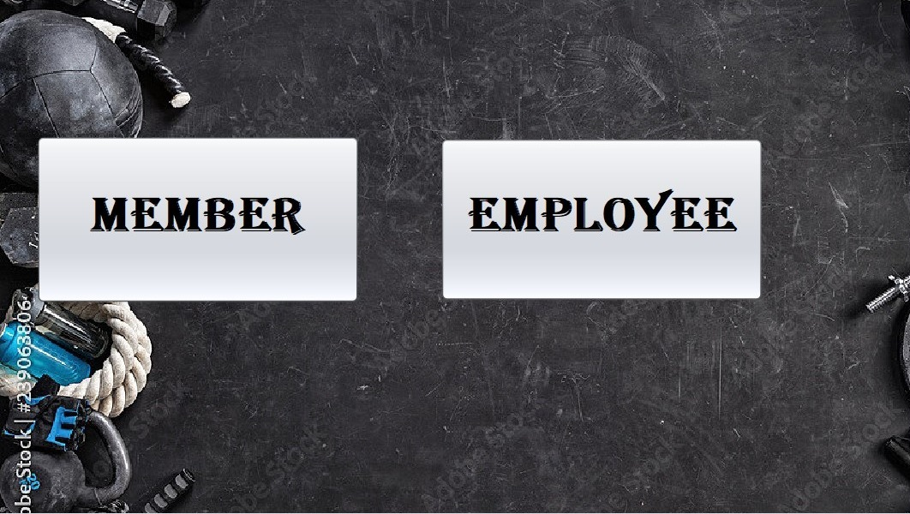
Define user type

Slide 9
If user selected member:

Slide 10
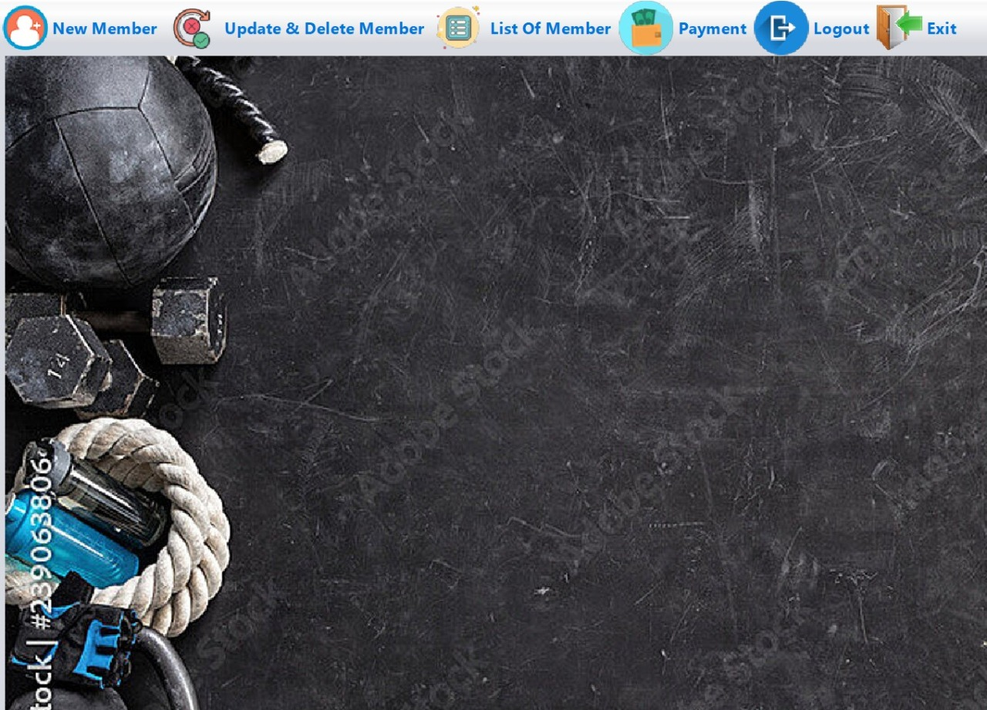
The first interface that a member sees after logging in

Slide 11
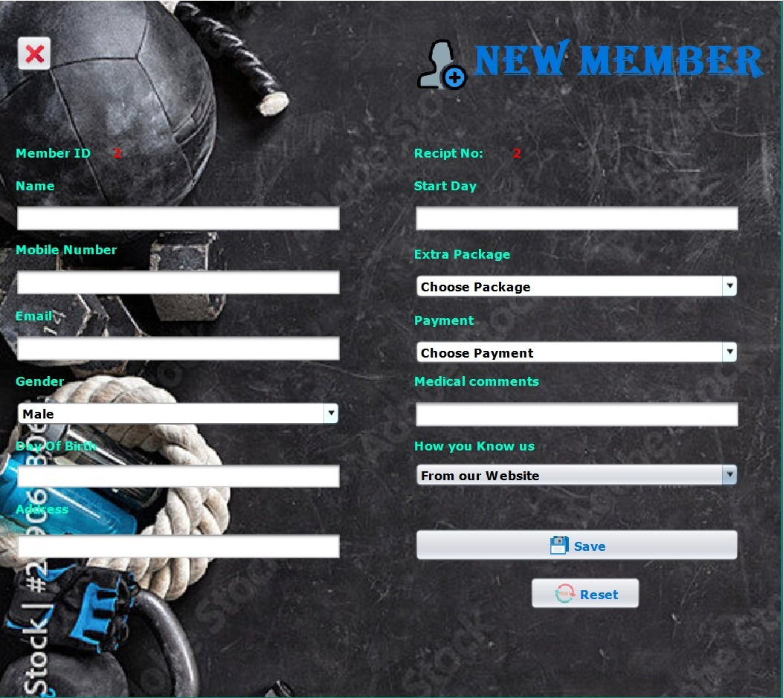
Creating new account for new members .

Slide 12
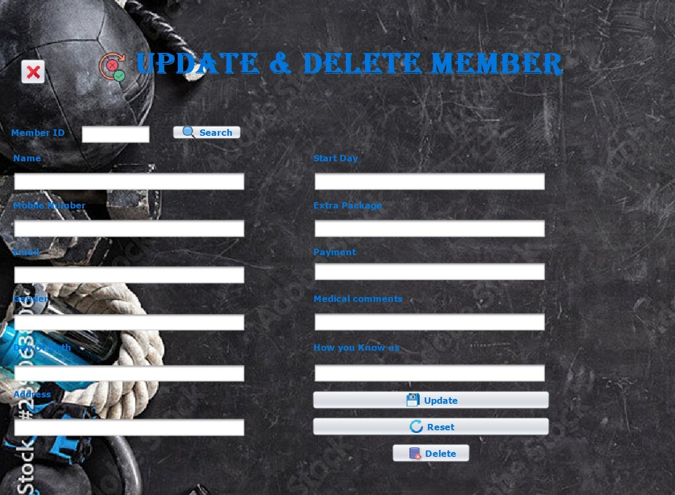
Updating or Deleting members (Special for Administrators)

Slide 13
If user selected employee :

Slide 14
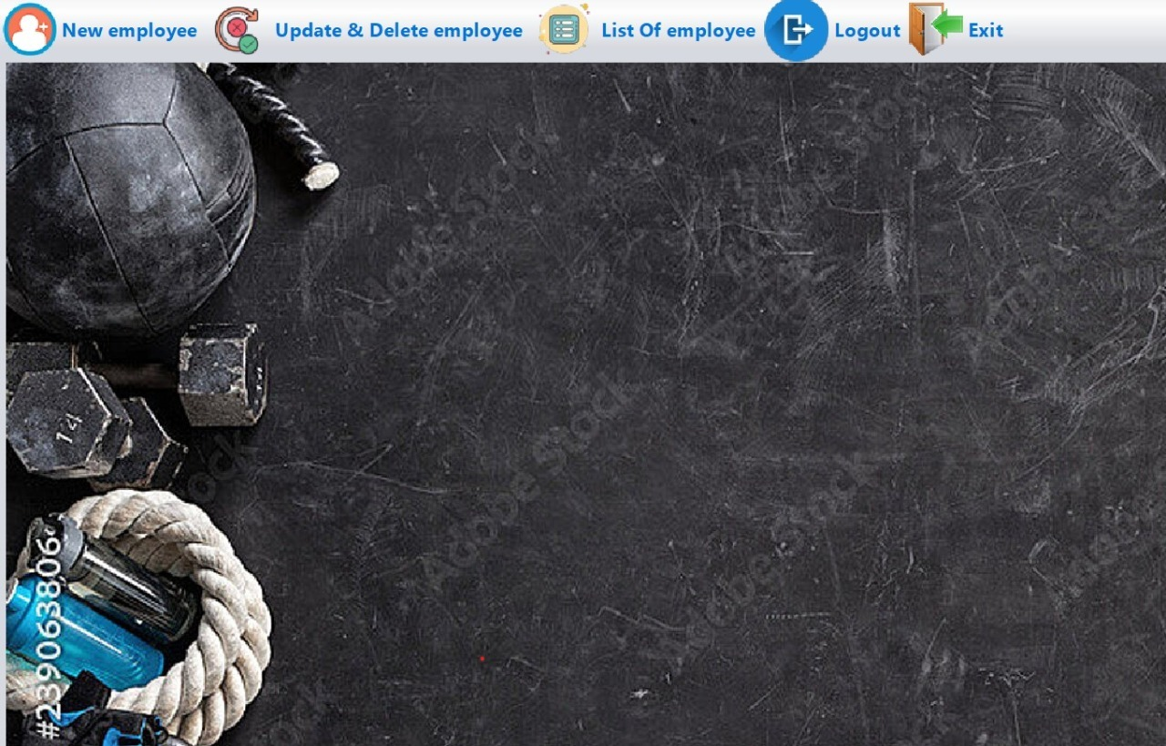
3)The first interface that an employee sees after logging in

Slide 15
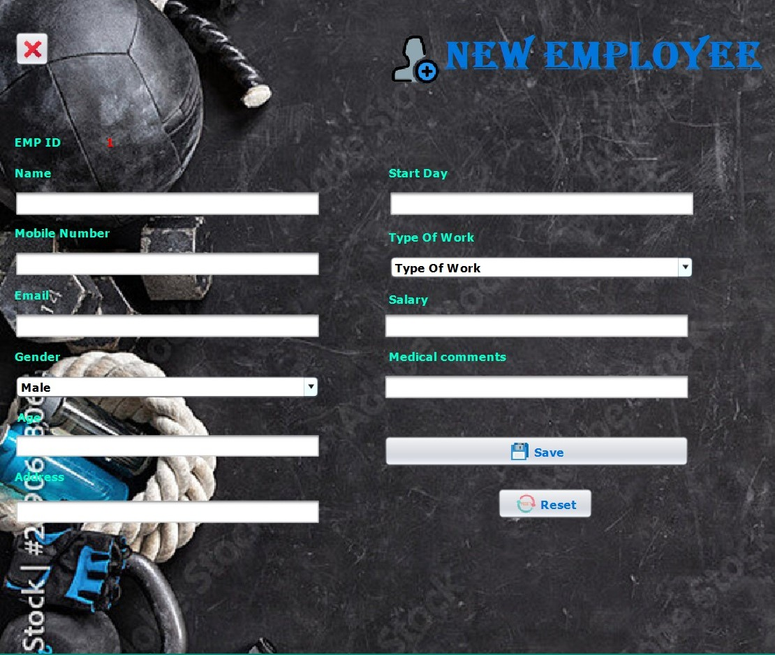
Adding New Employee

Slide 16
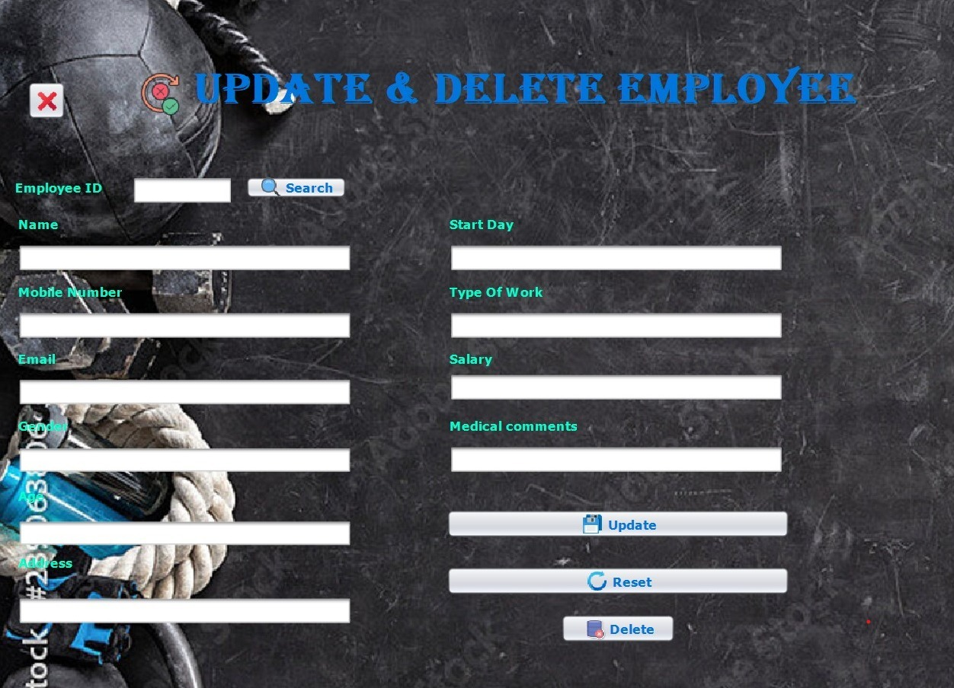
Updating or Deleting members (Special for Administrators)

Slide 17
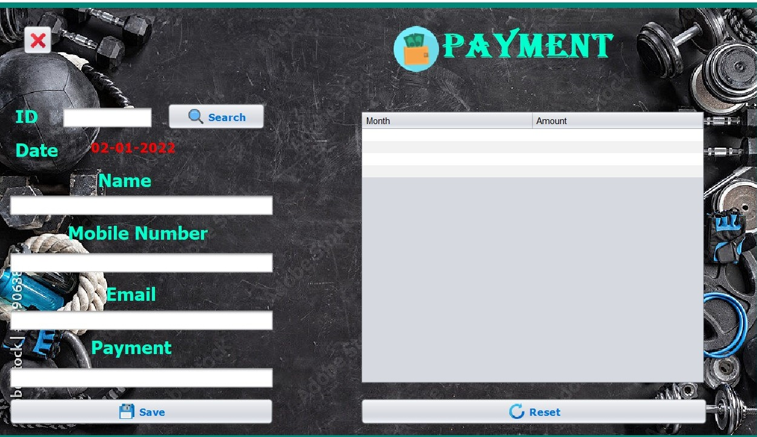
Searching Member’s payment using his / her ID .

Slide 18
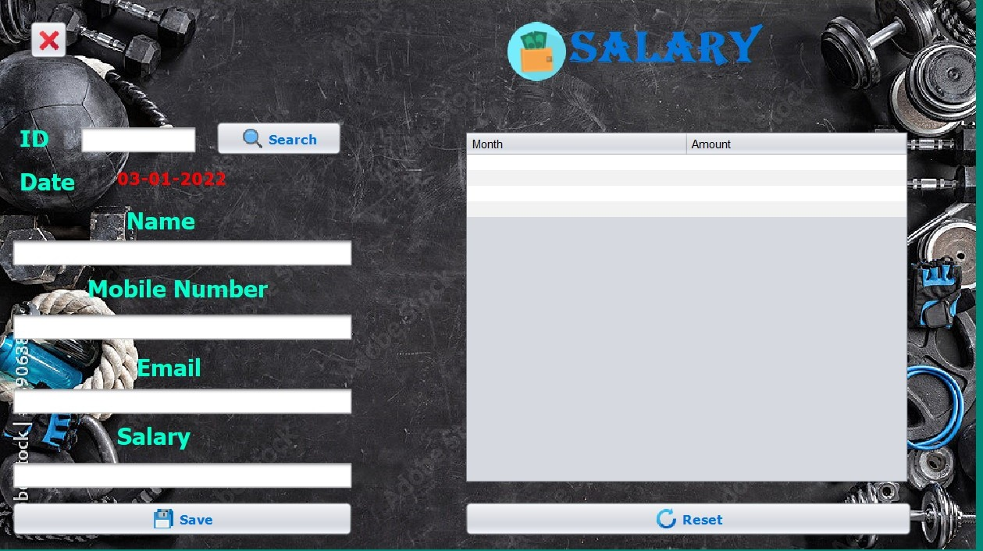
4) Searching Employees Salary using his / her ID .

Slide 19
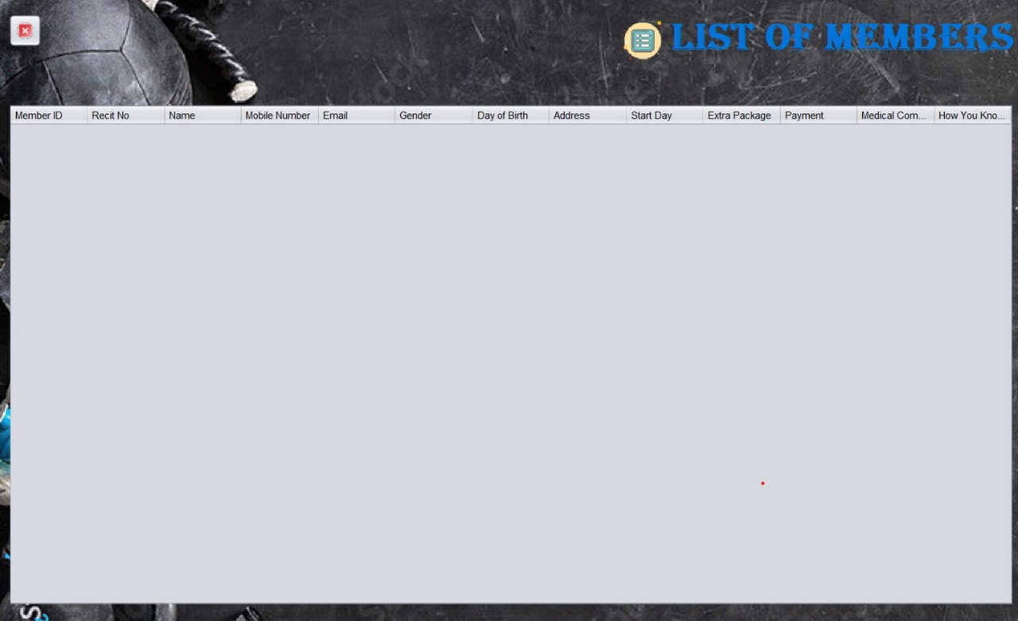
Simple sample list of gym members

Slide 20
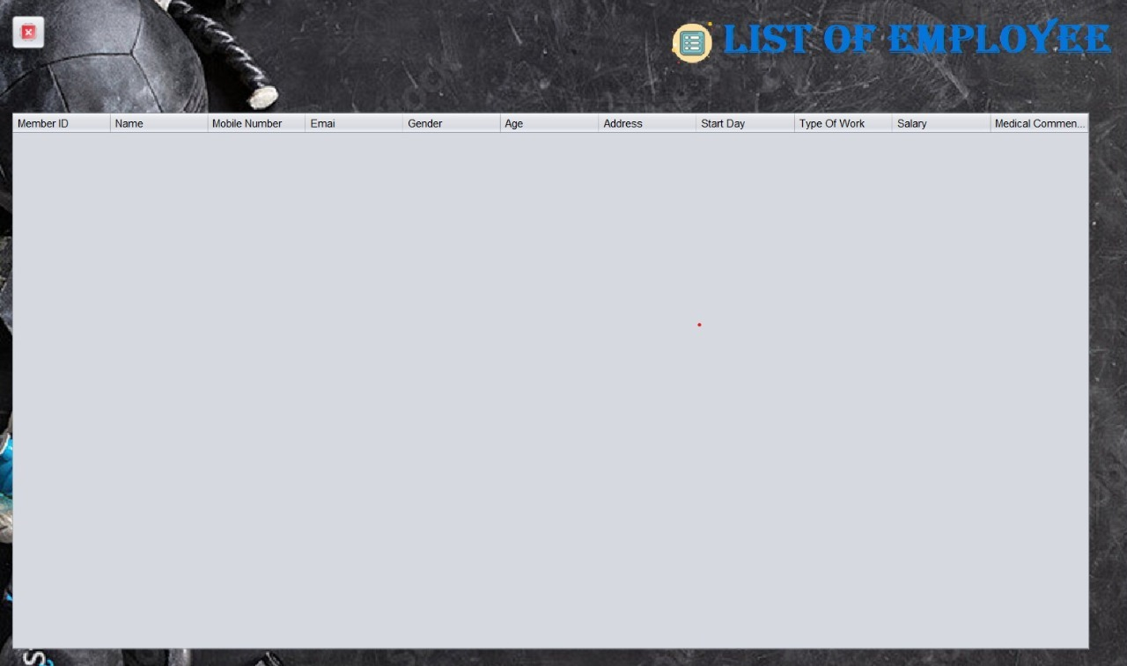
Simple sample list of gym Employee

Slide 21
Thanks ‘)

